Slide 1
Introduction to Data Analytics

Slide 2
Terminologies
Data – values or set of values, raw or unorganized.
Information – processed or meaningful data.
Analytics – discovery, interpretation and communication of meaningful patterns.
Analytics is not a tool or technology, rather it is a way of thinking and acting on data.

Slide 3
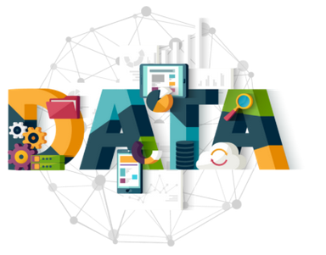
Data Analytics
Data Analytics can be defined as the process of analyzing raw data to find trends and answer questions.
Data Analytics refers to the techniques used to analyze data to enhance productivity and business gain.
Data is extracted from various sources and is cleaned and categorized to analyze various behavioral patterns.
The techniques and the tools used vary according to the organization or individual.

Slide 4
Role of Data Analytics
Gather Hidden Insights – Hidden insights from data are gathered and then analyzed with respect to business requirements.
Generate Reports – Reports are generated from the data and are passed on to the respective teams and individuals to deal with further actions for a high rise in business.
Perform Market Analysis – Market Analysis can be performed to understand the strengths and weaknesses of competitors.
Improve Business Requirement – Analysis of data enables better understanding of business requirements and hence the customer experience.

Slide 5
Data Analytics vs. Data Science
Data analysts typically work with structured data to solve tangible business problems using tools like SQL, R or Python programming languages, data visualization software, and statistical analysis.
Data scientists often deal with the unknown by using more advanced data techniques to make predictions about the future. They might automate their own machine learning algorithms or design predictive modeling processes that can handle both structured and unstructured data. This role is generally considered a more advanced version of a data analyst.
*Source: Coursera

Slide 6
Data Analytics vs. Data Science
Data analytics answers specific questions or address challenges that have already been identified and are known to the business.
Data scientist considers what questions the business should or could be asking. Involves design of new processes for data modeling - predictive models, custom analyses.

Slide 7
Data Analytics vs. Data Science
Data Analytics | Data Science
Collaborating with organizational leaders to identify informational needs | Gathering, cleaning, and processing raw data
Acquiring data from primary and secondary sources | Designing predictive models and machine learning algorithms to mine big data sets
Cleaning and reorganizing data for analysis | Developing tools and processes to monitor and analyze data accuracy
Analyzing data sets to spot trends and patterns that can be translated into actionable insights | Building data visualization tools, dashboards, and reports
Presenting findings in an easy-to-understand way to inform data-driven decisions | Writing programs to automate data collection and processing

Slide 8
Data Analytics vs. Data Science
 | Data Analytics | Data Science
Mathematics | Foundational math, statistics | Advanced statistics, predictive analytics
Programming | Basic fluency in R, Python, SQL | Advanced object-oriented programming
Software and tools | SAS, Excel, business intelligence software | Hadoop, MySQL, TensorFlow, Spark
Other skills | Analytical thinking, data visualization | Machine learning, data modeling

Slide 9
Types of Data Analytics
Descriptive analytics
Diagnostic analytics
Predictive analytics
Prescriptive analytics

Slide 10
Descriptive analytics
Descriptive analytics helps answer questions about what happened.
These techniques summarize large datasets to describe outcomes to stakeholders.
Key Performance Indicators (KPIs,) are used to keep track of successes or failures.
E.g. ROI (Return on Investment)
This process requires the collection of relevant data, processing of the data, data analysis and data visualization.
This process provides essential insight into past performance.

Slide 11
Diagnostic analytics
Diagnostic analytics helps answer questions about why things happened.
They take the findings from descriptive analytics and dig deeper to find the cause.
This generally occurs in three steps:
Identify anomalies in the data. These may be unexpected changes in a metric or a particular market.
Data that is related to these anomalies is collected.
Statistical techniques are used to find relationships and trends that explain these anomalies.

Slide 12
Predictive analytics
Predictive analytics helps answer questions about what will happen in the future.
These techniques use historical data to identify trends and determine if they are likely to recur.
It includes a variety of statistical and probability techniques.
E.g. how much the company revenue is likely to increase?

Slide 13
Prescriptive analytics
Prescriptive analytics helps answer questions about what should be done.
By using insights from predictive analytics, data-driven decisions can be made.
Prescriptive analytics techniques rely on machine learning strategies that can find patterns in large datasets.
By analyzing past decisions and events, the likelihood of different outcomes can be estimated.

Slide 14
Steps in Data Analytics
The primary steps in the data analytics process are:-
Data extraction
Data management/warehousing
Statistical analysis
Data presentation/visualization
The importance and balance of these steps depend on the data being used and the goal of the analysis.

Slide 15
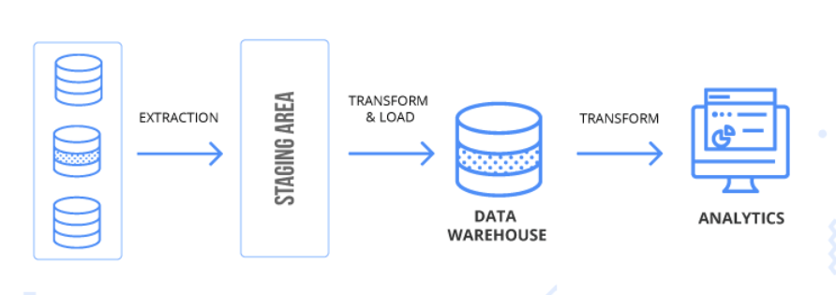
Data Extraction
It involves extracting data from unstructured data sources. E.g. text, large complex databases, or raw sensor data.
The key steps in this process are to extract, transform, and load data (often called ETL).
This prepares data for storage and analysis.
Data extraction is generally the most time-intensive step in the data analysis pipeline.

Slide 16
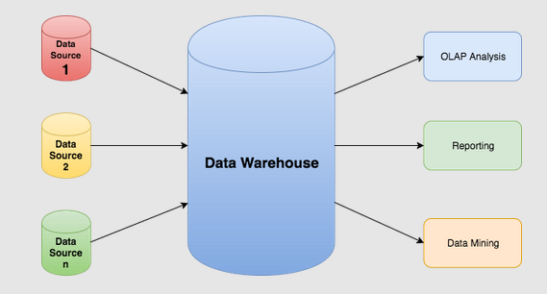
Data management /Data Warehousing
Data warehousing involves designing and implementing databases that allow easy access to the results of data mining.
This step generally involves creating and managing SQL databases.

Slide 17
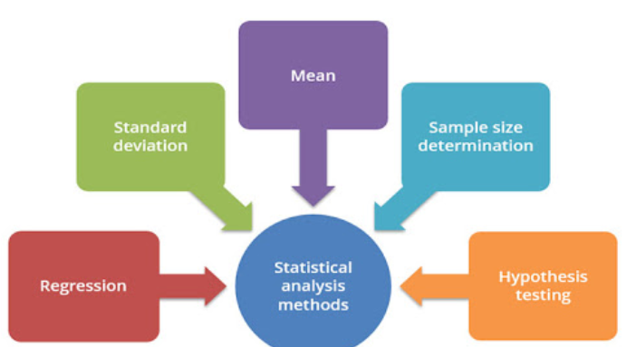
Statistical analysis
Statistical analysis allows analysts to create insights from data.
Both statistics and machine learning techniques are used to analyze data.
Programming languages such as R or Python are essential to this process.
In addition, open-source libraries and packages such as TensorFlow enable advanced analysis.

Slide 18
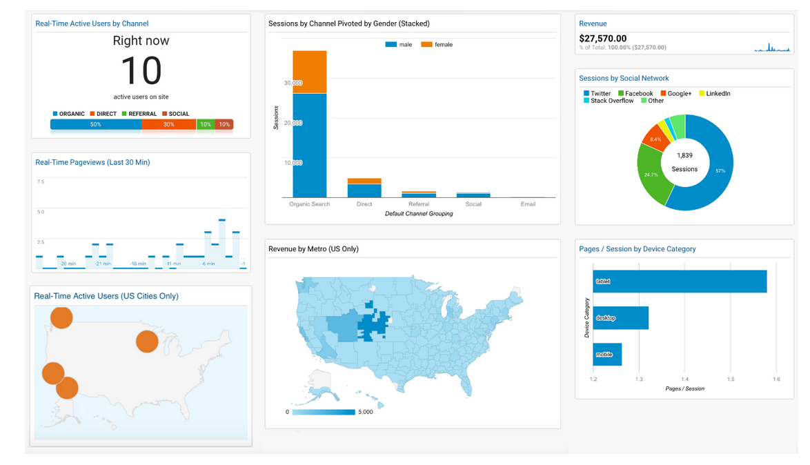
Data presentation/visualization
Visuals are used to describe the insights gained from the data.
Visualizations can help tell the story in the data which are much easier to understand.

Slide 19
Tools used in Data Analytics
R
Python
Tableau Public
free software that connects to any data source such as Excel, Data Warehouse, etc, then creates visualizations, maps, dashboards etc. with real-time updates on the web.
Microsoft Excel
RapidMiner
used for integration with data sources, mostly used for predictive analytics, such as data mining, text analytics, machine learning.
Apache Spark
One of the largest large-scale data processing engines, this tool executes applications in Hadoop clusters.

